Slide 1

PROJECT PRESENTATION IT 270
NAME:-N.D.G.M FERNANDO
STUDENT ID:-BSC/19/13/19

Slide 2
Presentation of management of class result sheet’s
Introduction of myself
Feature’s and importance of this program
Introduction of program

Slide 3
WHY THIS IS USEFUL PROGRAM?
This programme show and manage all results of the class
Time saving
GPA calculation

Slide 4
FEATURES
USE DIFF. HEADER FILES
USE IF ELSE, FOR, LOOPS, SWITCH, ARRAY

Slide 5
INPUTS
No. of students in class
Marks of 6 subjects
These marks out of 100
Credit hours of each subject

Slide 6
OUTPUTS
GRADES OF ALL SUBJECTS
SEMESTER CGPA

Slide 7
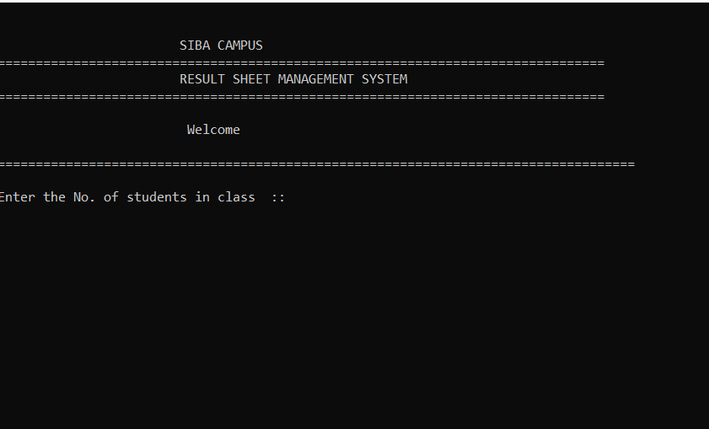
INTERFACE

Slide 8
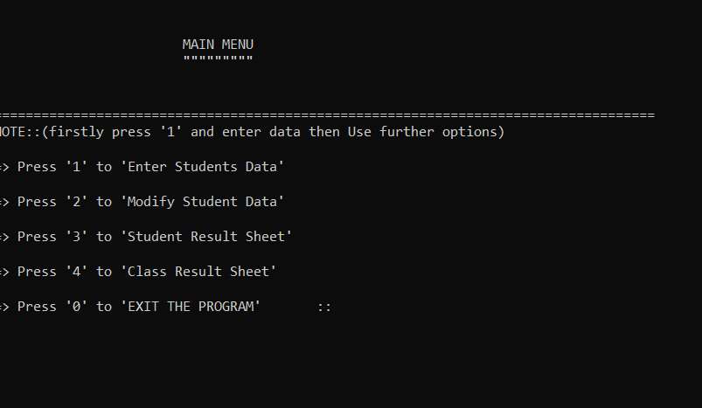
INTERFACE

Slide 9
Cpp linked file
Code

Slide 10
THANK
YOU

